Slide 1
Chapter 3 Hardware

Slide 2
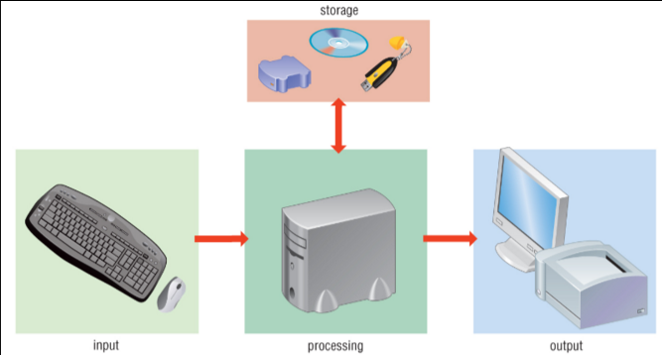
How computers work
During the information processing cycle, data is entered into a computer, processed, sent as output, and stored (if required for future use)

Slide 3
Typical set of Peripheral Devices(外部设备)
Input device: transmits data from the user to the computer processor
Output deice: conveys the results of processing from the computer processor to the user.
Storage device: can store data outside the processor.

Slide 4
3.1 Input device

Slide 5
Objective
show understanding of the basic internal operation of the following specific types of device:
– keyboard and keypad
– touchscreen (capacitive and resistive)
– optical mouse
– tracker ball
– Graphics Tablet
– microphone
– Barcode reader
– scanner / OCR
– OMR
– MICR
– Smart card / Magnetic stripes

Slide 6


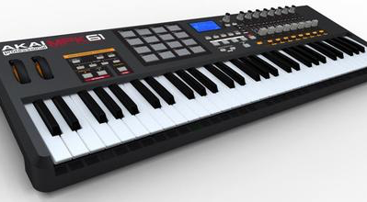
Keyboard and keypad

Slide 7
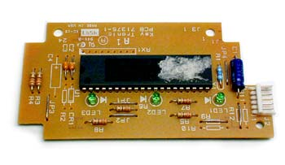
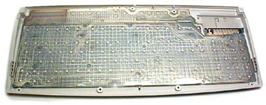
*keyboard
A keyboard is like a miniature computer. It has its own processor and circuitry that carries information to and from that processor.
When you press a key, it presses a switch, completing the circuit.
When the processor finds the circuit, it compares the location of that circuit on the key matrix to the character map in its read-only memory (ROM)
Inside the Keyboard
The key matrix
For example, the character map lets the processor know that pressing the a key by itself corresponds to a small letter "a" , but the Shift and a keys pressed together correspond to a capital "A“.
Notes:
标准键盘，英文键盘

Slide 8
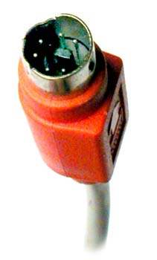
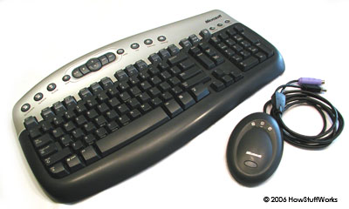
How keyboards connect to the computer
Many keyboards connect to the computer through a cable with a PS/2 or USB (Universal Serial Bus) connector.
Laptops use internal connectors.
Wireless keyboards connect to the computer through infrared (IR), radio frequency (RF) or Bluetooth connections.

Slide 9
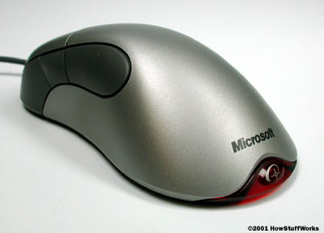
*Optical mouse
The optical mouse actually uses a tiny camera to take 1,500 pictures every second. Able to work on almost any surface, the mouse has a small, red light-emitting diode (LED) that bounces light off that surface onto a complementary metal-oxide semiconductor (CMOS) sensor.
The CMOS sensor sends each image to a digital signal processor (DSP) for analysis.
Based on the change over a sequence of images, the DSP determines how far the mouse has moved and sends the corresponding coordinates to the computer.
The computer moves the cursor on the screen based on the coordinates received from the mouse.

Slide 10
Benefit of optical mouse
No moving parts means less wear and a lower chance of failure.
There's no way for dirt to get inside the mouse and interfere with the tracking sensors.
Increased tracking resolution means smoother response.
They don't require a special surface, such as a mouse pad.

Slide 11
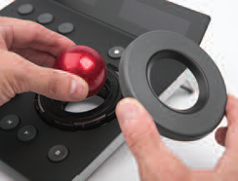
*Trackball
Trackballs work by using optical sensors to read the movements of dots on the surface of the ball. By tracking the direction in which the dots move, the optics translate the movement of the ball into moving the cursor.

Slide 12
Advantage and disadvantage
Advantage:
A trackball does not require any desk space for use since many are handheld.
Using a trackball has been compared to a joystick, and both are generally preferred by people who find their arm movements are unsteady when using a mouse.
Disadvantage：
It has a large size in comparison to a mouse.
Trackballs also cost more and have a narrower range of options than other input peripherals.

Slide 13
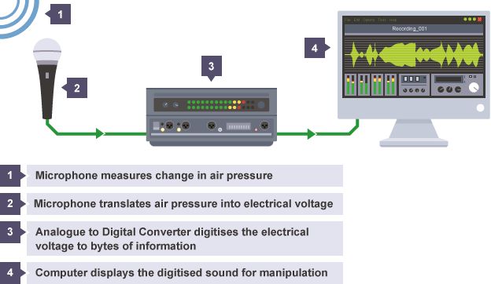
*Microphone

Slide 14
Digital audio quality
sample rate - the number of audio samples captured every second
bit depth - the number of bits available for each clip
bit rate - the number of bits used per second of audio

Slide 15
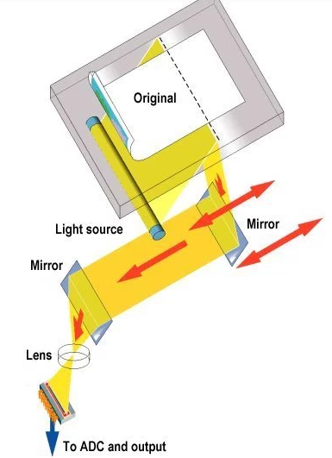
*Scanners
The image is placed before the carriage, consisting of a light source and sensor.
The amount of light transmitted through the image and picked up by the sensor, is then converted to a voltage.
Translate the voltage to digit signal by analogue-to-digital conversion (ADC).
Notes:
Conversely 相反的

Slide 16
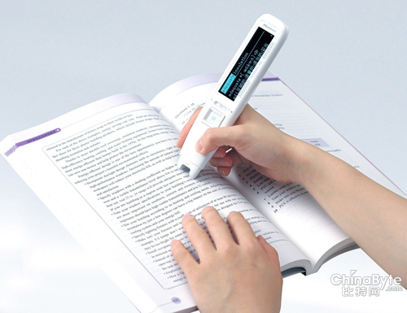
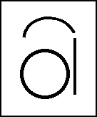
Optical Character Recognition
When a page of text is scanned into a PC, it is stored as an electronic file made up of tiny dots, or pixels.
In order to turn the group of pixels into editable words, the image must go through OCR.
OCR programs which use the pattern matching method have bitmaps stored for every character of each of the different font and type sizes.
By comparing a database of stored bitmaps distributed to the bitmaps of the scanned letters the program attempts to recognise the letters.

Slide 17
*Touch screen
Ref: https://display.ofweek.com/2014-11/ART-8321302-11000-28905254.html

Slide 18
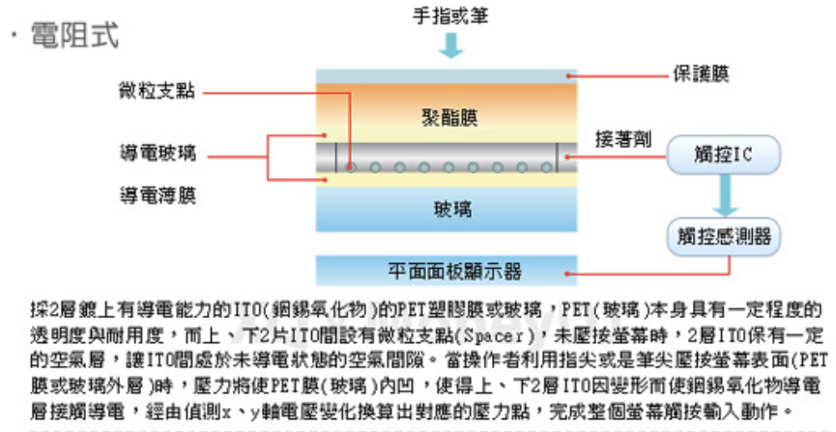
*Touch screen
Resistive touch screen
It composed of two flexible sheets coated with a resistive material and separated by an air gap or microdots.
When the conductive material is in contact, the voltages in the X direction and the Y direction change, and the contact position can be estimated.

Slide 19
Advantages and disadvantage
Advantage
Low production cost
High resistance to dust and water
Best used with a finger, gloved hand or stylus
Best suited for handwriting recognition
Disadvantages
Not too sensitive, you have to press down harder
Poor contrast because of having additional reflections from extra layer of material placed over the screen
Does not support multi-touch

Slide 20
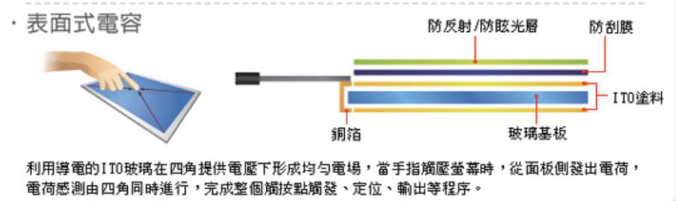
Capacitive touch screen
In the capacitive system, a layer that stores electrical charge is placed on the glass panel of the monitor.
There are electrodes on the four sides of the screen.A uniform electric field is created on the inside of the screen. When the finger touches the screen, it forms a capacitor with the screen.The strength of the current is functionally related to the distance from the finger to the electrode.

Slide 21
Advantage and disadvantage
Advantages of Capacitive Touchscreen
Because capacitive touchscreen has glass layer instead of plastic, it looks brighter and sharper
Highly touch sensititive and doesn’t need a stylus
Supports multi-touch
Disadvantages of Capacitive Touchscreen
Because the technology is dependent on the conductive nature of human body, it doesn’t work if the user is wearing gloves
Glass is more easily to breaking
Because of having a complex structure, these are quite expensive

Slide 22

Barcode readers
A laser scanner reads the reflected laser light from a series of dark and light coloured lines of varying thickness.
The different widths of pairs of lines make up a code that can be converted into a number.
This number can then be used as the key field relating to a file of items that have been barcoded.
Notes:
不同厚度的深色和浅色的线

Slide 23
Barcode readers
Advantages:
Faster data entry.
More accurate.
Disadvantages:
Barcodes can be damaged.
Can be difficult to get the barcode reader into a position to read the barcode on large items.
Notes:
很难阅读大物件上的条形码

Slide 24

Graphics Tablet
A flat surface on which a piece of paper is placed.
The user can then draw on the paper and the tablet will sense where the pencil is pointing and transfer the line to the screen.

Slide 25
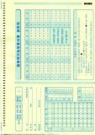
OMR (Optical Mark Reader)
Can recognise the presence of a mark on a sheet of paper.
The position of the mark conveys information to the machine.
Printing is done using a special type of ink which the optical scanner does not see.
Advantage:
Automatic and fast data entry.
Disadvantage:
Cannot read paper if folded or dirty.
Restricted to choice questions.
Notes:
Presence 存在
Restricted 限制

Slide 26
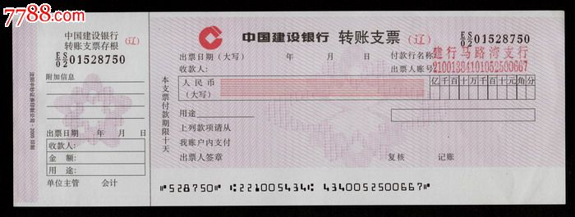
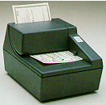
MICR (Magnetic Ink Character Reader)
Advantages:
Characters are readable by humans and by computers.
100% accurate when read by computer.
Disadvantages:
Expensive to print in magnetic ink.

Slide 27
1 Write down some example about each of the following input device.
A pointing devices:
B Image capture device:
C Sound and music capture device:
mechanical mouse, Optical mouse, touchpad, trackball, Joystick, Graphics tablet, Light pen
Scanner, Digital camera, Digital video camera, Webcam
Microphone

Slide 28
2 Describe the input devices used at an ATM machine.
An ATM machine uses a numeric keypad and buttons at the side of the screen. It may also use a
touch screen for some buttons.

Slide 29
3.
Words can be input to a computer using a microphone with voice recognition software or using a scanner with optical character recognition software (OCR).

Slide 30
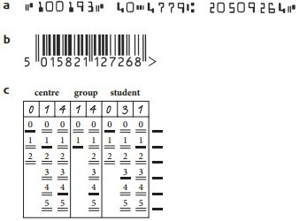
4.Name the data input type and the associated reader used to input the following characters and patterns into a computer
a This is an example of magnetic ink characters. They are read by a magnetic ink character recognition reader (MICR).
b This is an example of a barcode. It is read by a barcode reader.
c This is an example of a specialised form for data collection by optical mark recognition. It is read by an optical mark reader (OMR)

Slide 31
What is the principle of resistive touch screen and resistive touch screen?

Slide 32
resistive
− uses multiple layers of material …
− … that transmit electric currents
− when the top layer/screen is pushed/touched into the lower/bottom layer …
− … the electric current changes and location of “touch” is found
capacitive
− current sent/flows out from all 4 corners of the screen
− when finger/stylus touches screen, the current changes
− the location of “touch” is calculated

Slide 33
What are the advantages and disadvantages of capacitive touch screens and resistive touch screens?

Slide 34
Resistive
benefits:
−cheap to manufacture
− can use stylus/finger/gloved finger/pen
drawbacks:
− poor visibility in sunlight
− it is easy to scratching
− does not allow multi-touch facility
Capacitive
benefits:
− good visibility in sunlight
− (very) durable surface
− allows multi-touch facility
drawbacks:
− screen (glass) will break/crack
− cannot use when wearing gloves

